Slide 1
Data Analysis Biodiversity for the National Parks
By Scotty Brooks

Slide 2
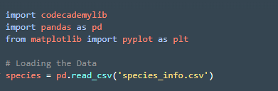
Biodiversity Project
Given a csv file with data about different in our National parks.
The data included: Scientific name, Common name, and conservation status of each species.
I analyzed the data using python pandas

Slide 3
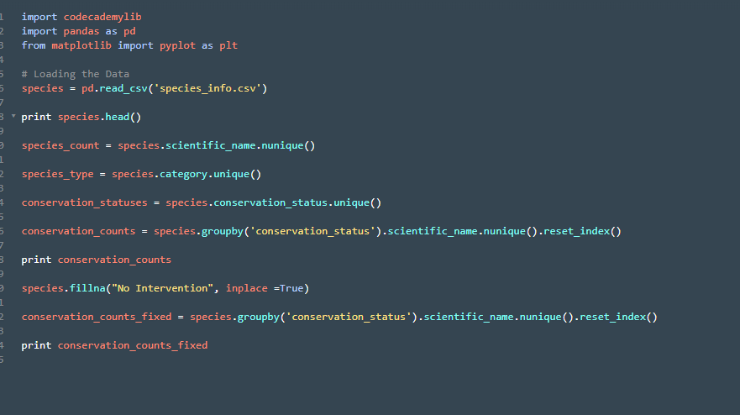
Inspecting Data
I wanted to figure out how many different species and conservation status are in the data frame.
To do this I had to create a new columns within the data frame.
Then use the groupby, and uniqure as well as the nunique funtions to filter the data Frame.
When pandas is working row by row it’s crucial to .reset_index()

Slide 4
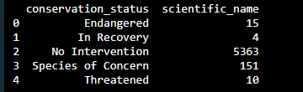
Analyzing Species Conservation Status
I wanted to see how many species were in each status. To do this I would have to filter the data.

Slide 5
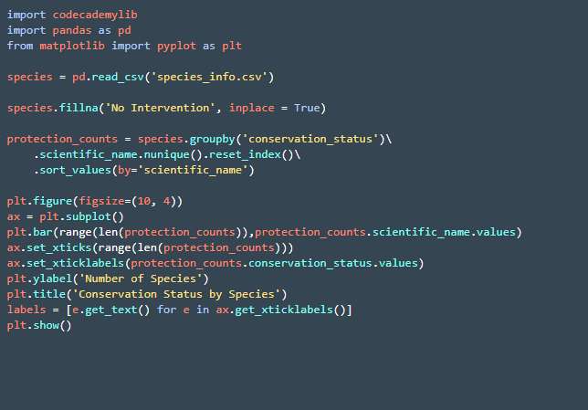
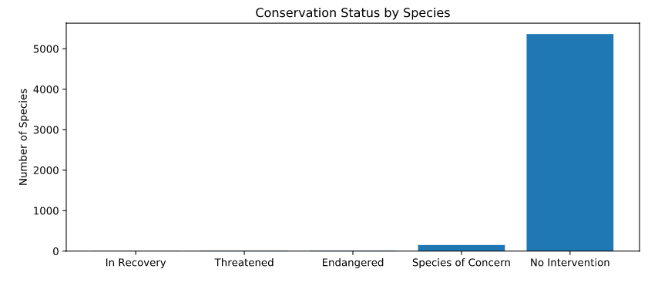
Plotting
This graph shows the # of each species in the 5 different conservation status – As you can see “No intervention” is the majority of the species. -

Slide 6
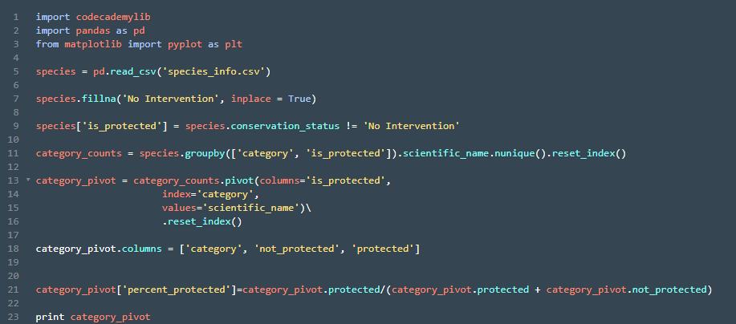
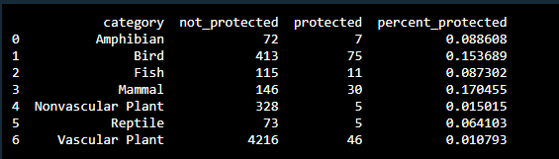
Pivot Table
To figure out which species are more likely to become endangered I needed to figure out which species are protected or not.
To do this I created a new column in the dataframe that if the conservation status is “No Intervention” then the species is protected.
Then create a pivot table

Slide 7
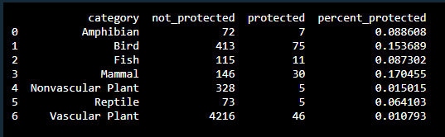
More on the Pivot Table
Once the data was filtered to “No intervention” and we classified those species as “protected”
Once classified we wanted to know how many of each species were protected to not protected
Once filtered by species and protected and not protected we wanted to calculate the % of protected species per species category.

Slide 8
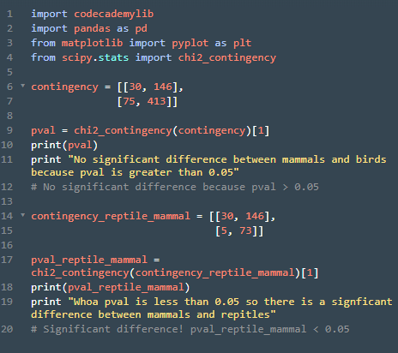
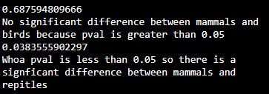
Chi-Squared Test for Significance
The pivot table showed that mammals and birds have the highest percentage of being “protected”
But are mammals more likely to endangered then birds?
What about mammals to reptiles?

Slide 9

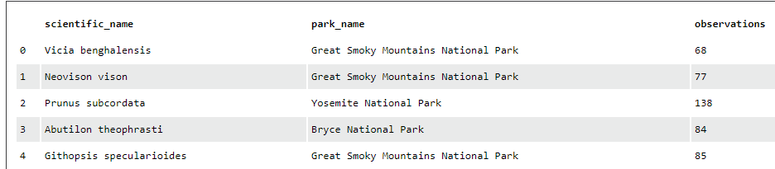
Observations dataframe
Got a new data frame called observations
Load it and analyze the data

Slide 10
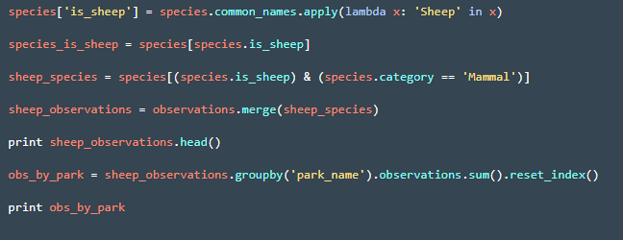
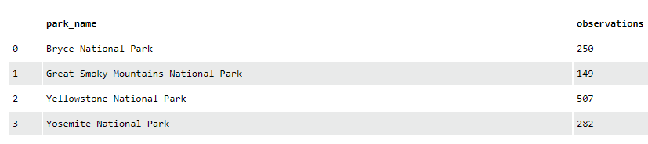
Search of Sheep
Using a lambda function create new column called “is_sheep”
Then merge data frame to show sheep oberservations

Slide 11
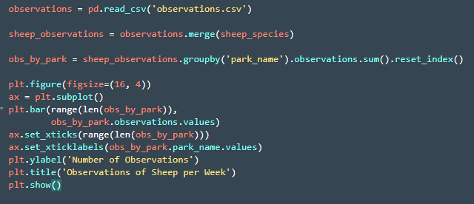
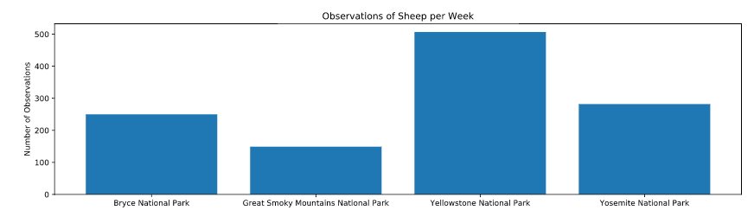
Plot the sheep sightings
Import matplot lib and plot
Make sure you use the plt.bar(range(len to size the bins
Don’t forget to label the bar chart

Slide 12
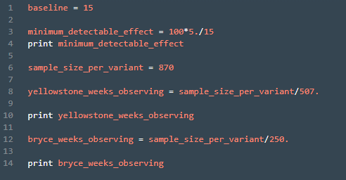
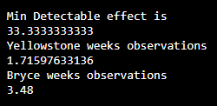
Foot and Mouth reduction
We need to determine the sample size.
To do this we need: Baseline%, Min Detectable Effect, and Statistical significance rate
The example gave us all 3 of these.

